Slide 1

SVG
CAP 5738 Data Visualization
Spring 2018
Dr. Sayeed S. Alam

Slide 2
SVG
Scalable Vector Graphics commonly known as SVG is a XML based format to draw vector images.
It is used to draw two dimensional vector images.
SVG is intended to display images over the web.
Being vector images, SVG image never loses quality no matter how they are zoomed out or resized.
SVG images supports interactivity and animation.
SVG is a W3C standard.

Slide 3
Advantages/Disadvantages of SVG
Advantages:
Use any text editor to create and edit SVG images.
Being XML based, SVG images are searchable, indexable and can be scripted and compressed.
SVG images are highly scalable as they never loses quality no matter how they are zoomed out or resized
Disadvantages:
Being text format size is larger then compared to binary formatted raster images.
Size can be big even for small image.

Slide 4
Syntax
<svg width="100" height="100">
<circle cx="50" cy="50" r="40" stroke="red" stroke-width="2" fill="green" />
</svg>

Slide 5
SVG Shapes
Different SVG shapes:
rect
circle
ellipse
line
polygon
polyline
path

Slide 6
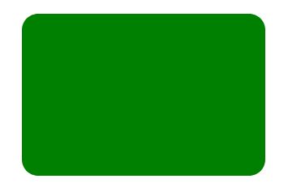
Rectangles
<rect x="10" y="10" width="30" height="30"/>
X: The x position of the top left corner of the rectangle.
Y: The y position of the top left corner of the rectangle.
width: The width of the rectangle
height: The height of the rectangle
rx, ry : x-radius/y-radius of the corners of the rectangle
<rect x="60" y="10" rx="10" ry="10" width="30" height="30" fill='green'/>

Slide 7
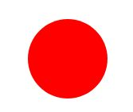

Circle/Ellipse
<circle cx="250" cy="250" r="50" style="fill:red"/>
<ellipse cx="75" cy="75" rx="20" ry="50"/>

Slide 8



Line/Polyline/Polygon
<line x1="10" x2="50" y1="110" y2="150" stroke="orange" stroke-width="5"/>
polyline points="60 110, 65 120, 70 115, 75 130, 80 125, 85 140, 90 135, 95 150, 100 145" stroke="orange" fill="transparent" stroke-width="5"/>
<polygon points="50 160 55 180 70 180 60 190 65 205 50 195 35 205 40 190 30 180 45 180" stroke="green" fill="transparent" stroke-width="5"/>

Slide 9
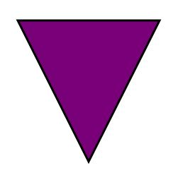
Paths
<path d="M 100 100 L 300 100 L 200 300 Z" stroke="black" stroke-width="3" fill="rgb(121,0,121)"> </path>
M 100 100 moves drawing pointer to (100,100)
L 300 100 draws a line from (100,100) to (300,100)
L 200 300 draws a line from (300,100) to (200,300)
z closes the path.

Slide 10
Path Commands
M − move to − move from one point to another point.
L − line to − create a line.
H − horizontal line to − create a horizontal line.
V − vertical line to − create a vertical line.
C − curve to − create a curve.
S − smooth curve to − create a smooth curve.
Q − quadratic Bezier curve − create a quadratic Bezier curve.
T − smooth quadratic Bezier curve to − create a smooth quadratic Bezier curve
A − elliptical Arc − create a elliptical arc.
Z − close path − close the path.

Slide 11
Path Commands – lower cases
In case of lower case commands, the relative path is used
M 100 100 L 200 100 Z is Equivalent to
M 100 100 l 100 0 z
L 200 100 – draws a line from 100,100 to 200,100
l 100 0 draws a line from current pointer to 100 right side to it

Slide 12
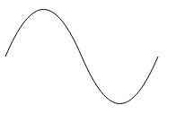
Path Curvers
<path d="M10 80 C 40 10, 65 10, 95 80 S 150 150, 180 80" stroke="black" fill="transparent"/>

Slide 13
SVG Texts
<text x="30" y="12" >Text: </text>
x/y , dx/dy – absolute/relative position
Rotate: rotation of all characters
Textlength: rendering length of the text.

Slide 14
Nested elements
Tspan :
<text x="10" y="22" >Text:
<tspan dx ="10" dy ="10"> Text2 </tspan>
</text>
Tpath:
<path id="my_path" d="M 20,20 C 40,40 80,40 100,20" fill="transparent" />
<text>
<textPath xlink:href="#my_path">This text follows a curve.</textPath>
</text>

Slide 15
Hyperlinks
<a xlink:href="http://www.tutorialspoint.com">
<rect x="100" y="80" width="300" height="100“ style="fill:rgb(121,0,121);stroke-width:3;stroke:rgb(0,0,0)" />
</a>

Slide 16

Images
<image xlink:href="images/cartman.jpg" x="0" y="0" height="50px" width="50px"/>

Slide 17
SVG Transformations
Translation:
<rect x="0" y="0" width="10" height="10" transform="translate(30,40)" />
Rotations:
<rect x="12" y="-10" width="20" height="20" transform="rotate(45)" />

Slide 18
Grouping
The <g> SVG element is a container used to group other SVG elements. Transformations applied to the <g> element are performed on all of its child elements, and any of its attributes are inherited by its child elements.
<g stroke="green" fill="white" stroke-width="5">
<circle cx="25" cy="25" r="15"/>
<circle cx="40" cy="25" r="15"/>
<circle cx="55" cy="25" r="15"/>
<circle cx="70" cy="25" r="15"/>
</g>

Slide 19
SVG Reusability
SVG allows graphical objects to be defined for later reuse.
<defs>
<g id="Port">
<circle style="fill: inherit;" r="10"/>
</g>
</defs>
<use x="50" y="50" href="#Port" style="fill: blue;"/>

Slide 20
Fill and Stroke
<rect x="10" y="10" width="100" height="100" stroke="blue" fill="purple" fill-opacity="0.5" stroke-opacity="0.8"/>
Stroke properties:
Stroke (for color)
Stroke-width
stroke-linecap
stroke-opacity

Slide 21
Advanced Topics
Filter
Gradients
Patterns
Clipping and Masking

Slide 22
References
https://www.tutorialspoint.com/svg
https://developer.mozilla.org/en-US/docs/Web/SVG/Tutorial
https://www.w3schools.com/graphics/svg_intro.asp

Slide 23
Thank You

